Slide 1
Carbon Dioxide Capture and Conversion
Matthew Katterman

Slide 2
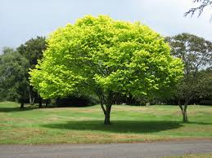
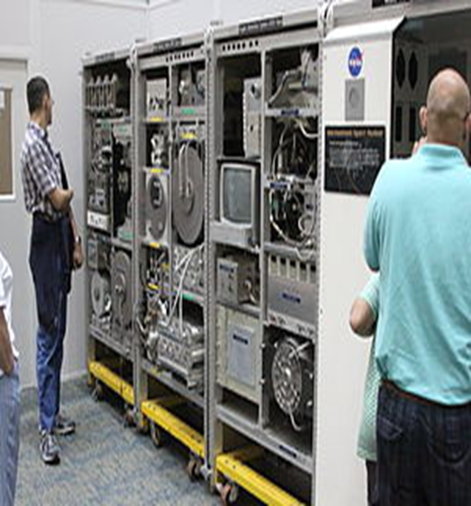
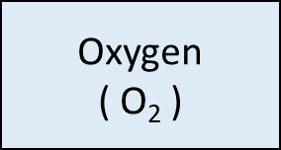


Cycling of Carbon Dioxide in Nature and on Space Station
Water
( H₂O )
Carbon Dioxide
( CO₂ )
Carbon Dioxide
( CO₂ )

Slide 3
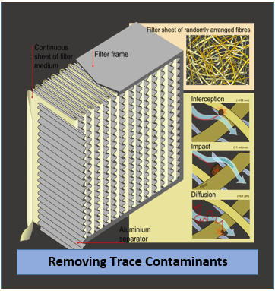
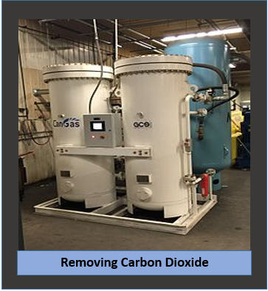
The Air Revitalization System
Removes Carbon Dioxide and Air Contaminants
From the Air Space

Slide 4
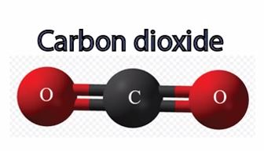
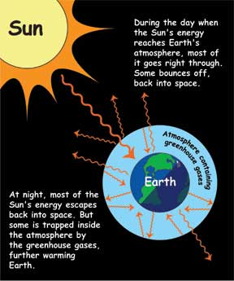
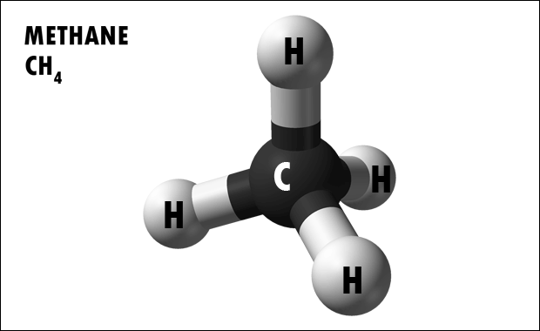
Greenhouse gas effect
Certain gases trap heat in the atmosphere

Slide 5
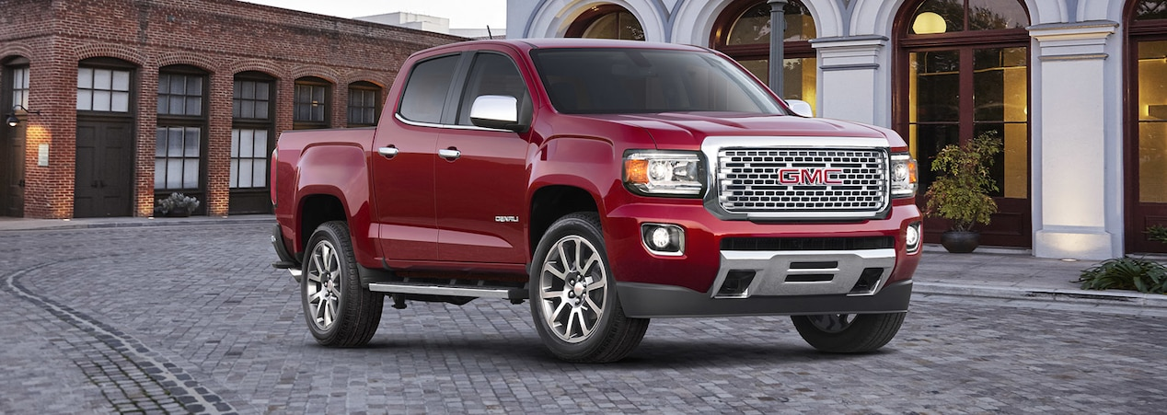
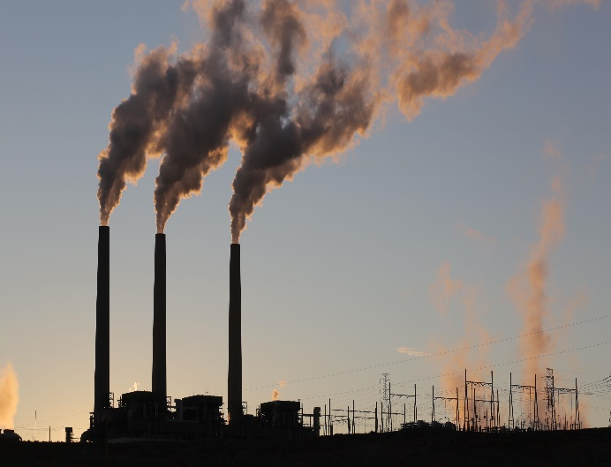
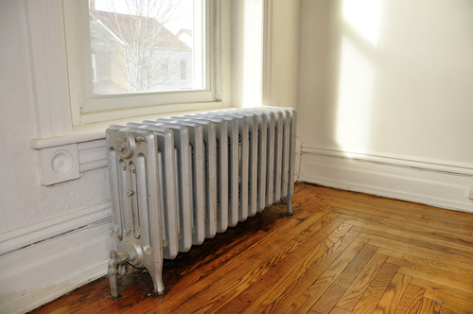
Carbon dioxide emissions
Combustion of fossil fuels creates Carbon Dioxide
Fossil Fuels = Natural gas, Coal, Petroleum
Car – Gasoline Coal - Electricity Natural gas - heating

Slide 6
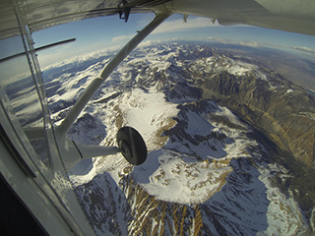

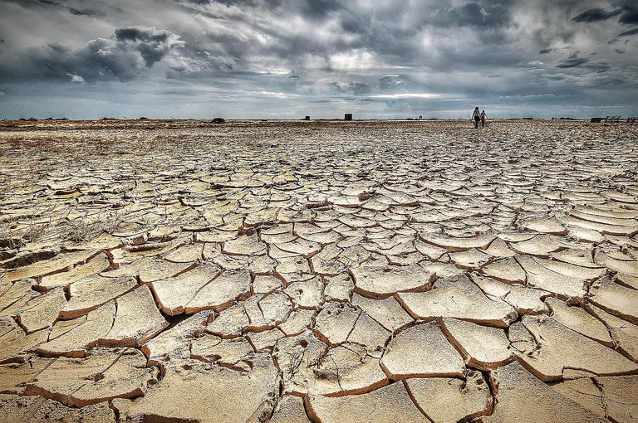
Climate change
Scientists believe Our carbon emissions are causing …
Changing Weather Patterns
snow levels intense rains droughts

Slide 7

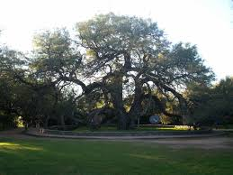
Ways to remove carbon dioxide
Carbon
Dioxide
Grow Algae
Plant Trees

Slide 8
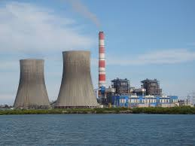
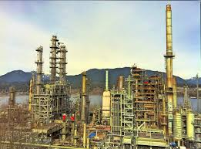
Capturing & Recycling Carbon Dioxide
Coal Power Plant
Oil Refinery
Capture Carbon
Dioxide
Pump Carbon
Dioxide Underground
Store underground
Create more oil

Slide 9
Converting Carbon Dioxide into Chemicals
CO₂ CO₂
CO₂ CO₂
CO₂ CO₂
CO₂ CO₂
CO₂ CO₂
FORMIC ACID
It is desirable to capture carbon dioxide
and convert it into other things. Sometimes
this means adding it to something else or having
it react and form another compound.

Slide 10
What happens when we add carbon dioxide to dissolved gummy worms?
CO₂ CO₂
CO₂ CO₂
CO₂ CO₂
CO₂ CO₂
Gummy worms
added to vinegar
Gummy worms dissolve
in vinegar and change color
What happens when carbon
dioxide is added?

